Slide 1

EFFECTS OF CANNABIS LEGALIZATION
GW DATA ANALYTICS BOOTCAMP
PROJECT 1 / TuTh SECTION / GROUP3

Slide 2
OUR TEAM
ALPHABETICALLY BY FIRST NAME
JT
MALVIKA
MARIE
SABA
TIM
“I just want to beat Sam”
Von Seggern
Mathur
Minier
Lemma
Lindner
BACKGROUND
BACKGROUND
BACKGROUND
BACKGROUND
BACKGROUND
Degree in Physics with Mathematics minor
Neurobiology & Physiology major
Corporate Strategy & Operations
Information Design
Master’s degree in Public Health
Chemistry degree
High School chemistry teacher
CONTRIBUTIONS
CONTRIBUTIONS
CONTRIBUTIONS
CONTRIBUTIONS
CONTRIBUTIONS
Gathered crime data for the states analyzed; Visually represented the crime in each state per county by year; amazing motivator
Gathered state data on legalization, gathered and plotted crime data analysis.
Helped compile data on cannabis legislation in states; Constructed project narrative and presentation
Calculated the z-score of the crime-rate
Collected, scrubbed, and analyzed population data, incorporated rural vs urban categorization
2

Slide 3
TOPICS CONSIDERED
INITIAL BRAINSTORM
POPULATION
TOURISM
OPIOID
RELATED DEATHS
CRIME
AIRBNB
CANNABIS
LEGALIZATION
HOTELS
PROJECT SUMMARY
3
Notes:
Talk through this slide very briefly.

Slide 4
PRESENTATION OUTLINE
APRIL 21, 2018
1. PROJECT SUMMARY
2. EXPLORE & DISCOVER
3. TIME TO ANALYZE
4. DISCUSS & CONCLUDE
5. LESSONS LEARNED
6. QUESTIONS & ACCOLADES
4

Slide 5
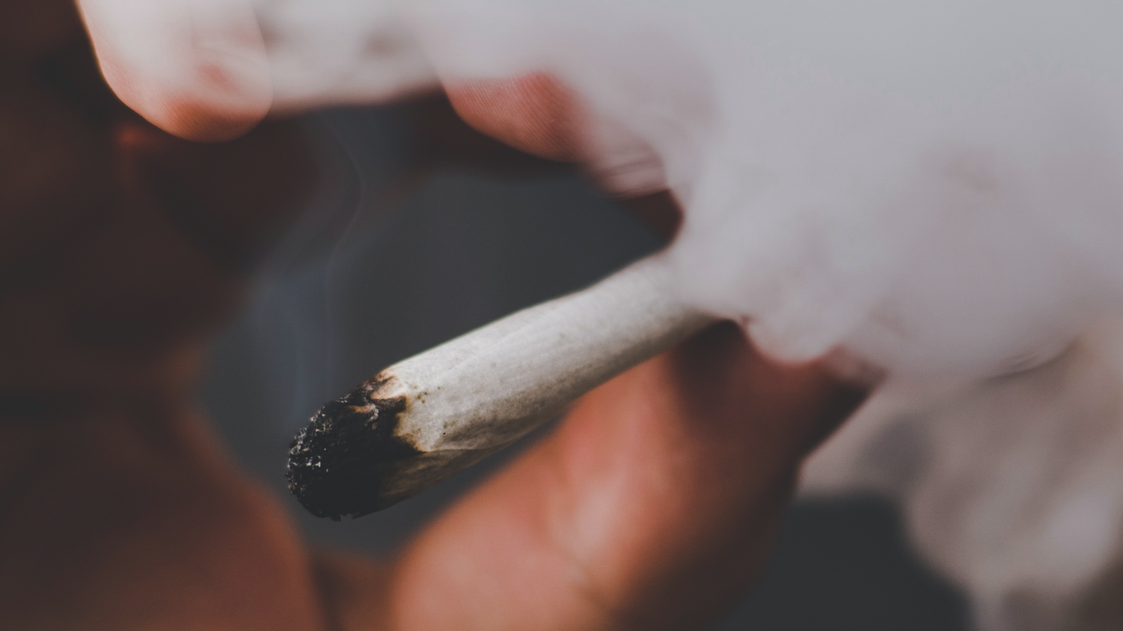
PROJECT SUMMARY
PART 1

Slide 6
FIRST THINGS FIRST…
LEGALIZATION OF CANNABIS FOR RECREATIONAL USE
“Blah blah blah legalization blah blah…”
PROJECT SUMMARY
6
Notes:
We are going to be using the term legalization several times throughout this presentation.
When we do so, we are referring very specifically to the… legalization of cannabis for recreational use.
Specifically state that we’re not talking about/considering medical

Slide 7
The relationship between population and crime
“The analysis of the 2000 UCR crime data for the 1,294 cities with populations over 25,000 revealed a significant positive relationship between crime rate and population size,”
J.J. Nolan III / Journal of Criminal Justice 32
Pg 552
http://theipti.org/wp-content/uploads/2012/02/covariance.pdf
“a reduction of population growth will dramatically reduce the growth of the crime rate.”
POPULATION AND CRIME
AUST.N.Z.J.C. (1975) 8
Pg 61
https://www.anu.edu.au/fellows/jbraithwaite/_documents/Articles/1975_Population%20Growth%20and%20Crime.pdf
“we can say that the hypothecated relationship between population diversity and violence entertained by this research enjoyed considerable support in the analysis reported below.”
Further evidence on the relationship between population diversity and violent crime
Gregory J. Howard,Graeme Newman & Joshua D. Freilich
Pages 203-229 | Published online: 01 Jun 2011
https://www.tandfonline.com/doi/abs/10.1080/01924036.2002.9678688
Notes:
From the cites above we can say that crime tends to increase with population. Therefore, from this we created our project statement.

Slide 8
PROJECT STATEMENT
Our project is to discover whether the legalization of recreational cannabis
has had any impact on the relationship
between population and crime in that state.
PROJECT SUMMARY
8
Notes:
We believe that as population increases in states where weeeeeeed is legal, crime does not increase as much in states that have not legalized.

Slide 9
OUR RESEARCH QUESTIONS
IS THERE A CORRELATION BETWEEN LEGALIZATION OF CANNABIS AND THE GROWTH/DECLINE OF CRIME OR POPULATION IN A GIVEN STATE/CITY?
HAS LEGALIZATION IMPACTED POPULATION GROWTH IN RURAL VS. URBAN AREAS?
ARE THERE ANY TRENDS THAT WE OBSERVER IN RELATION TO CRIME AND POPULATION THAT COULD BE USED AS PREDICTORS FOR STATES THAT HAVE YET TO LEGALIZE?
PROJECT SUMMARY
9
Notes:
HYPOTHESIS: The Legalization of Cannabis will affect this relationship between population and crime rate.

Slide 10
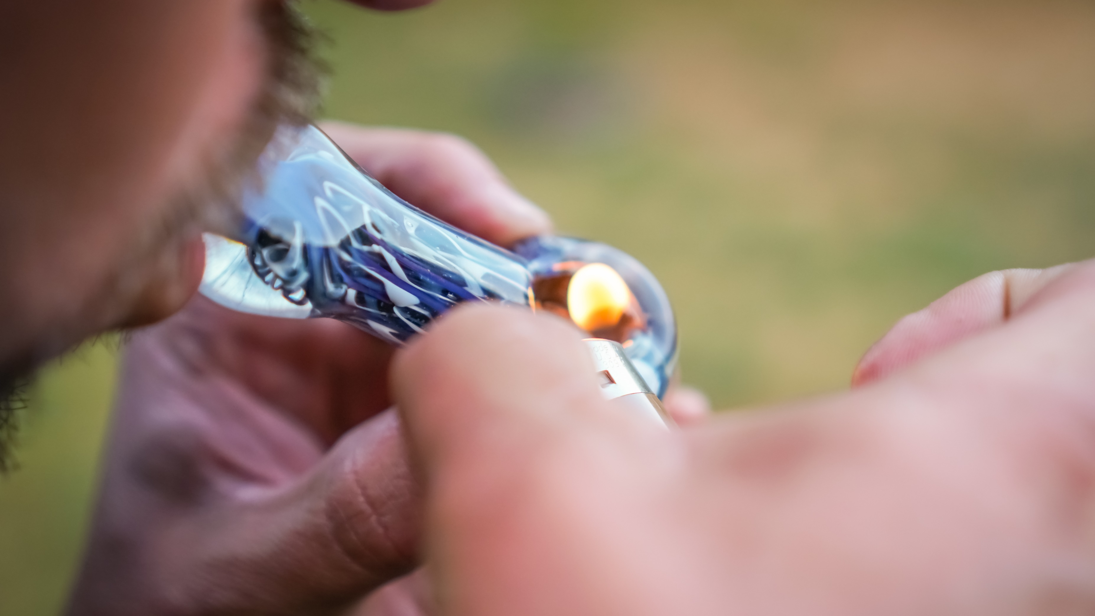
PART 2
EXPLORE & DISCOVER

Slide 11



OUR PROCESS
WHAT WE DID
1
DEFINE QUESTION
2
FIND & EXPLORE DATA
3
CLEAN & VISUALIZE DATA
4
ANALYZE & DISCUSS FINDINGS
5
DOCUMENT
EXPLORE & DISCOVER
11
Notes:
Loop it, check it, refine it

Slide 12
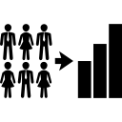


PRIMARY DATA SOURCES
CANNABIS
RESEARCH
POPULATION DATA
CRIME DATA
National Cannabis Industry Association thecannibisindustry.org
County Population by Characteristics: 2010-2016, United Census Bureau
www.census.gov
Urban vs. Rural Counties as of 2010, United Census Bureau
www.census.gov
Crime in the United States: 2010-2016, Uniform Crime Reporting, Federal Bureau of Investigation (FBI)
ucr.fbi.gov
Crime Data Explorer, FBI
crime-data-explorer.fr.cloud.gov
EXPLORE & DISCOVER
12

Slide 13
REVISING SCOPE
Recreational Use Legal
2012
2 States
Washington DC
2014
2 States + DC
2016
4 States
2018
1 State
EXPECTED2018
6 States
EXPLORE & DISCOVER
13
Notes:
Discuss how we narrowed scope down to the states we ultimately selected.
**Number of states that have legalized.

Slide 14
STATES SELECTED
2012
WASHINGTON
COLORADO
Washington DC
2014
OREGON
2016
CALIFORNIA
EXPLORE & DISCOVER
14
Notes:
Discuss how we narrowed scope down to the states we ultimately selected.
**Number of states that have legalized.

Slide 15

PART 3
DATA ANALYSIS

Slide 16
OUR APPROACH
TIME TO ANALYZE
16
Notes:
No need for this slide.
DISCUSS THE STEPS WE TOOK TO ANALYZE THE DATA AND ANSWER EACH QUESTION WE ASKED IN OUR PROPOSAL.
PRESENT INTERESTING FIGURES DEVELOPED DURING ANALYSIS IDEALLY WITH THE HELP OF JUPYTER NOTEBOOK

Slide 17
INITIAL FINDINGS
TIME TO ANALYZE
17
Notes:
No need for this slide.
DISCUSS THE STEPS WE TOOK TO ANALYZE THE DATA AND ANSWER EACH QUESTION WE ASKED IN OUR PROPOSAL.
PRESENT INTERESTING FIGURES DEVELOPED DURING ANALYSIS IDEALLY WITH THE HELP OF JUPYTER NOTEBOOK

Slide 18
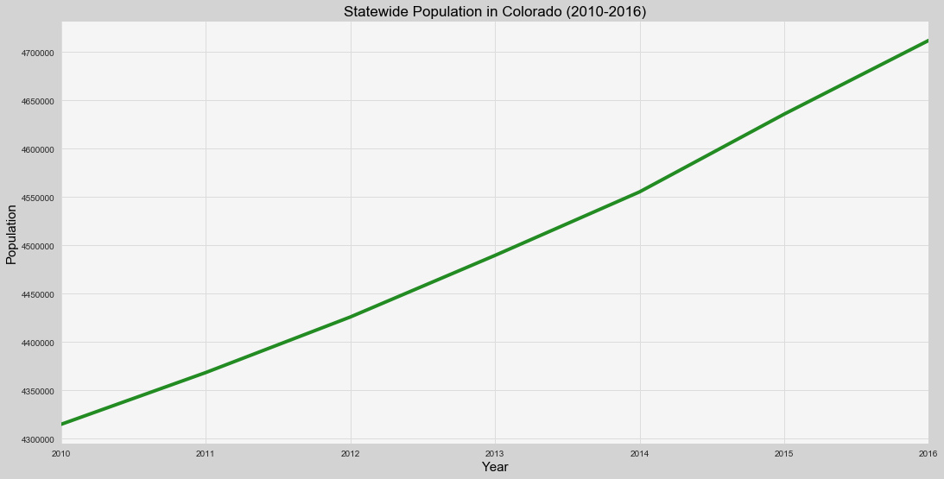
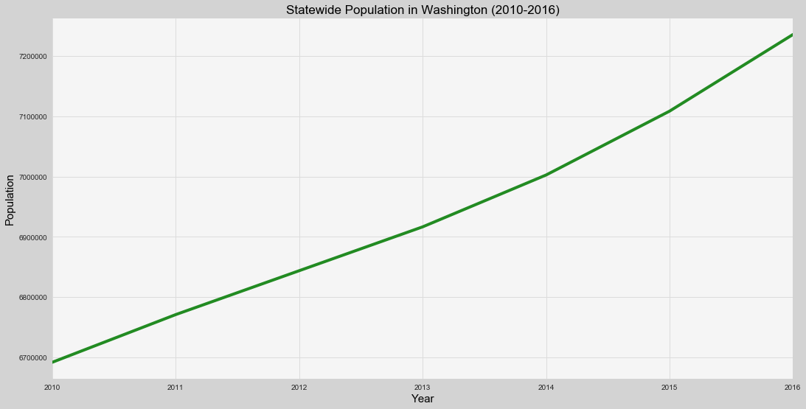
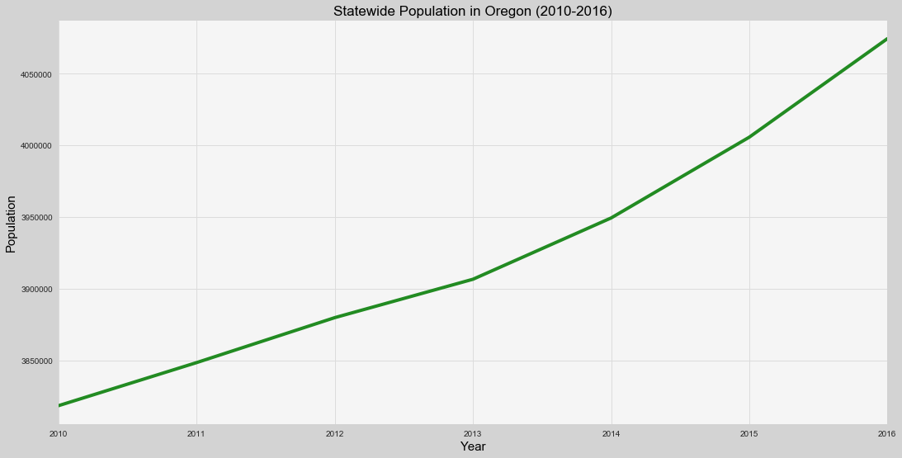
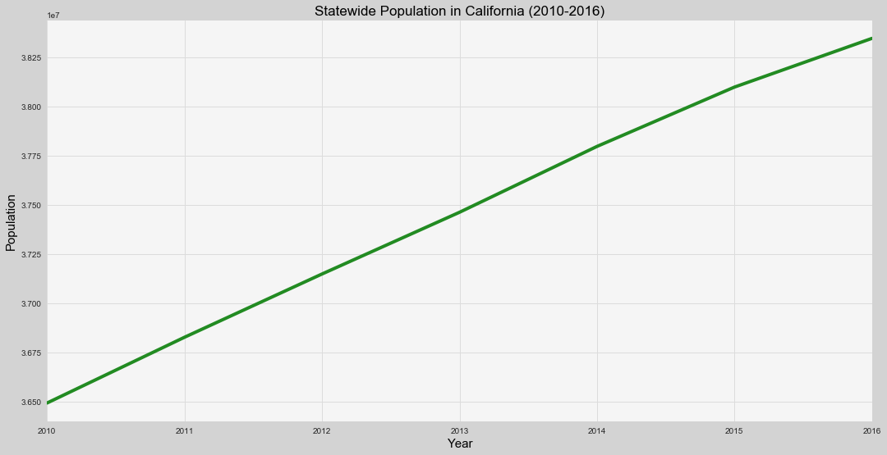
STATE-WIDE POPULATION OVER 2010-2016
Recreational
Retail
COLORADO
WASHINGTON
OREGON
CALIFORNIA

Slide 19
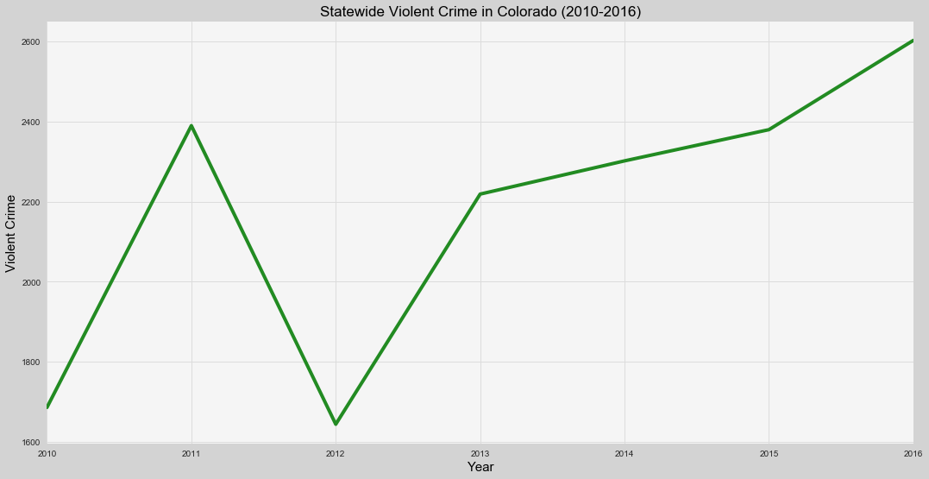
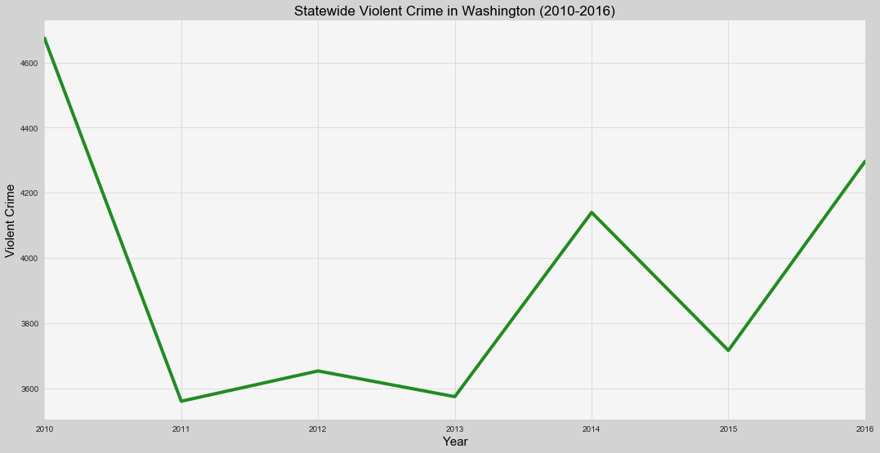
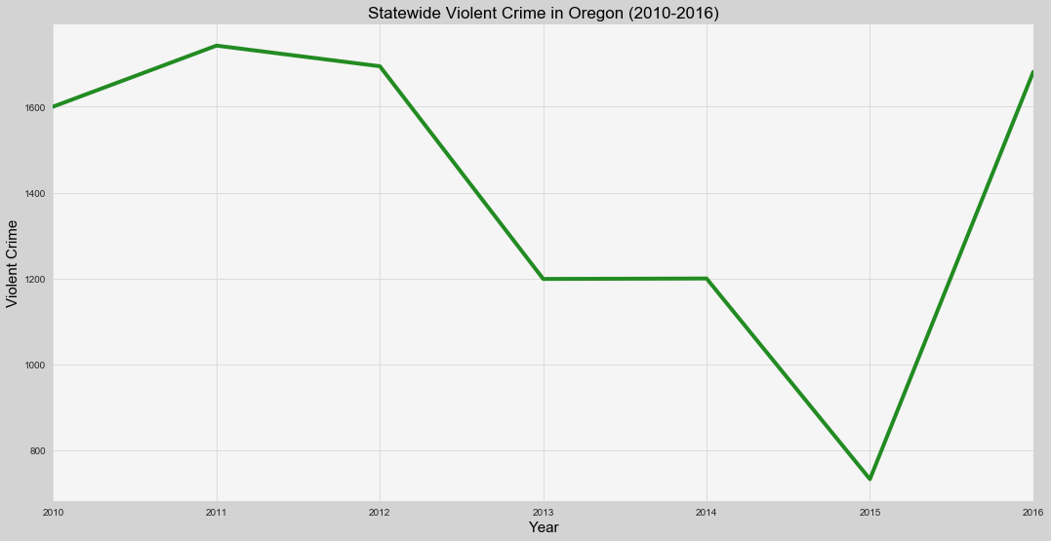
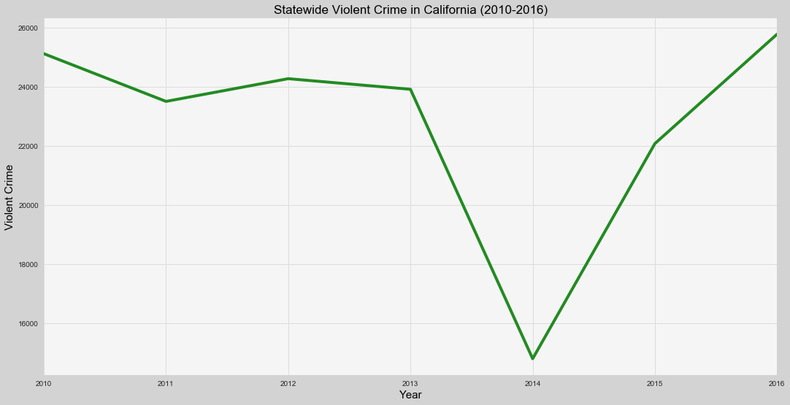
STATE-WIDE CRIME OVER 2010-2016
Recreational
Retail
COLORADO
WASHINGTON
OREGON
CALIFORNIA
Notes:
This is where we need to explain our rural vs urban stuff.
The us census bureau assigns each county in the united states an “urban percentage”.
We’ve called “urban” any county that is between 80 and 100 % urban by population, and rural is between 0 and 40 % urban.
Anything smaller than 0-40% was unreliable, as there just aren’t any counties that fall in that category in a lot of states.

Slide 20
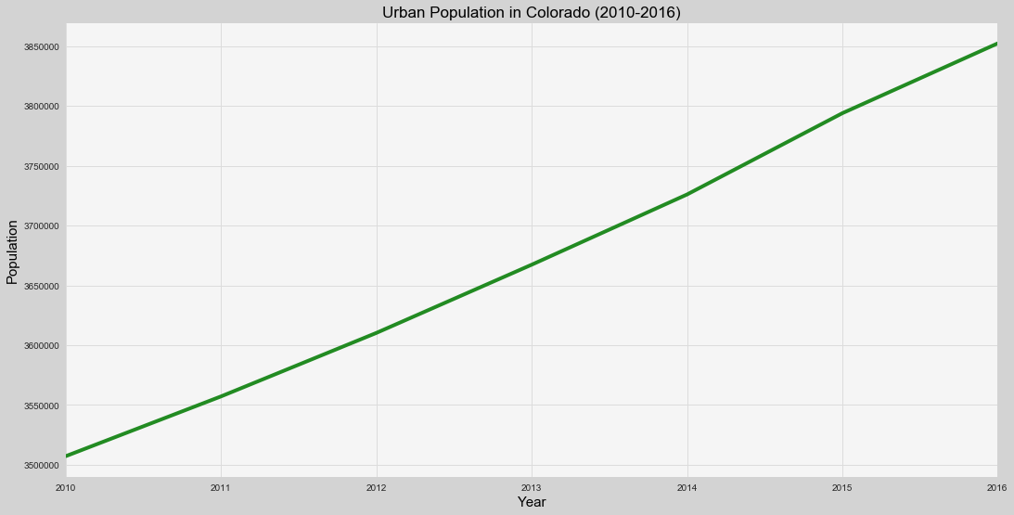
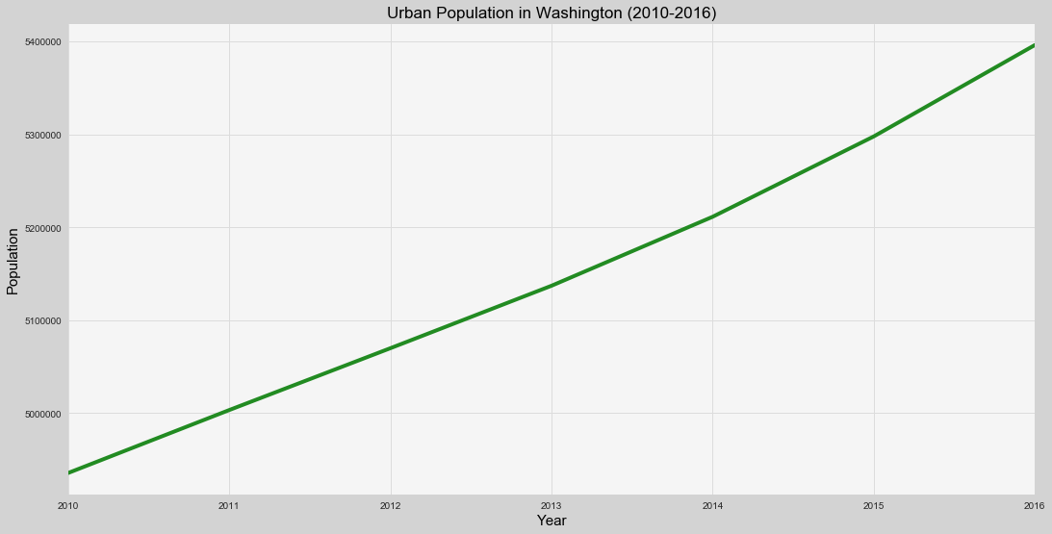
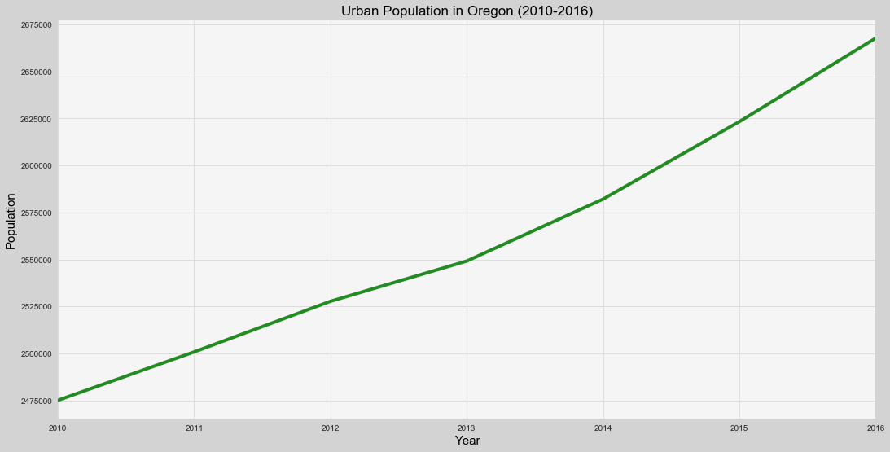
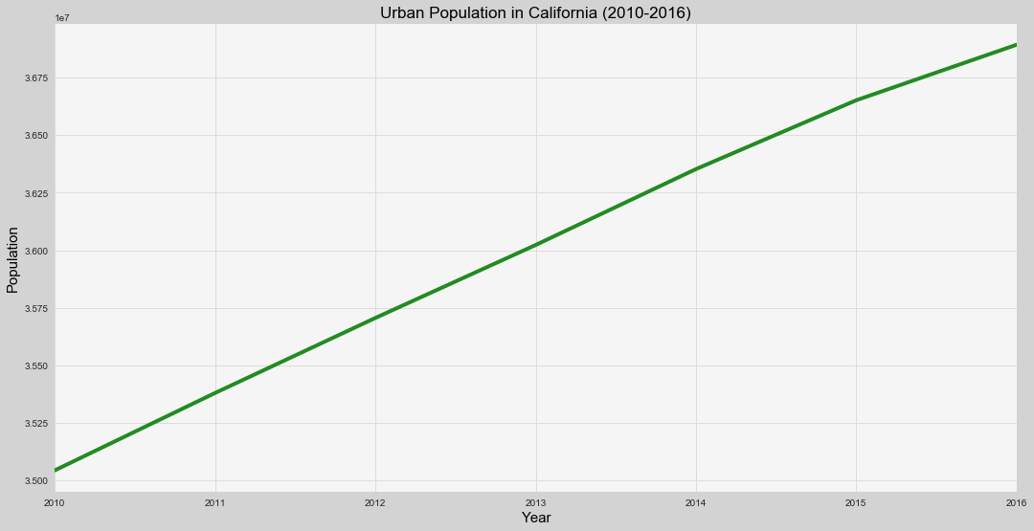
URBAN POPULATION OVER 2010-2016
Recreational
Retail
COLORADO
WASHINGTON
OREGON
CALIFORNIA

Slide 21
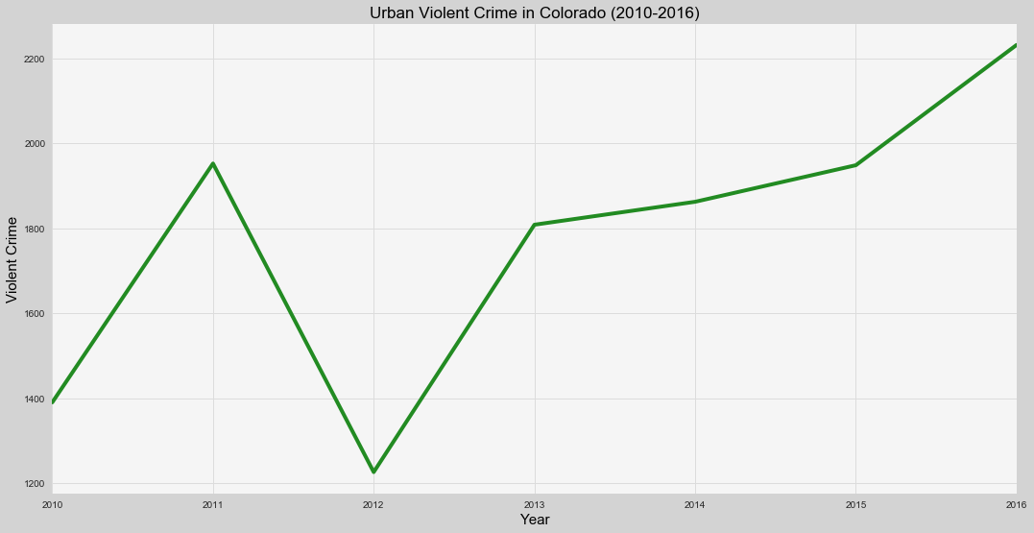
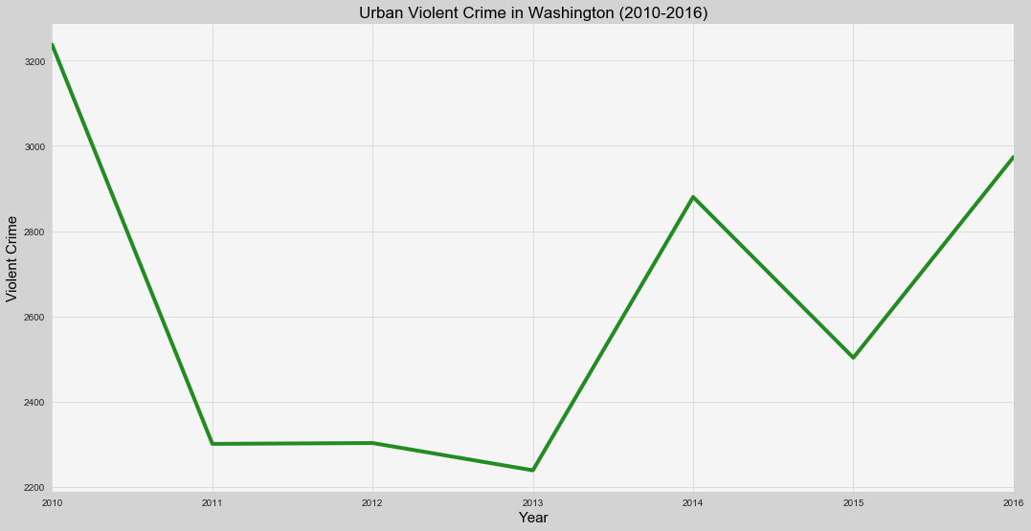
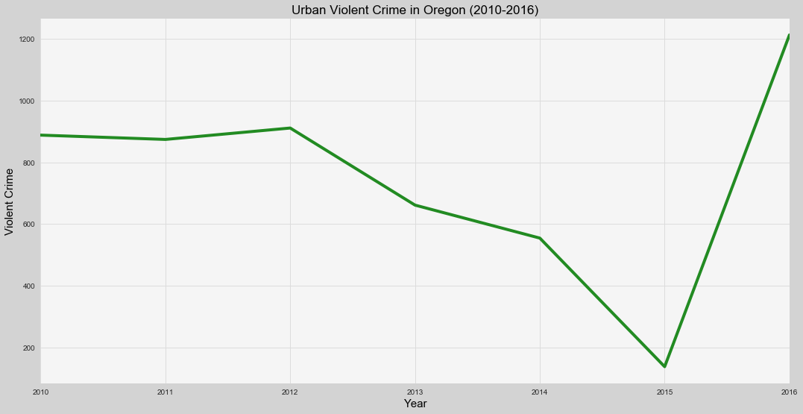
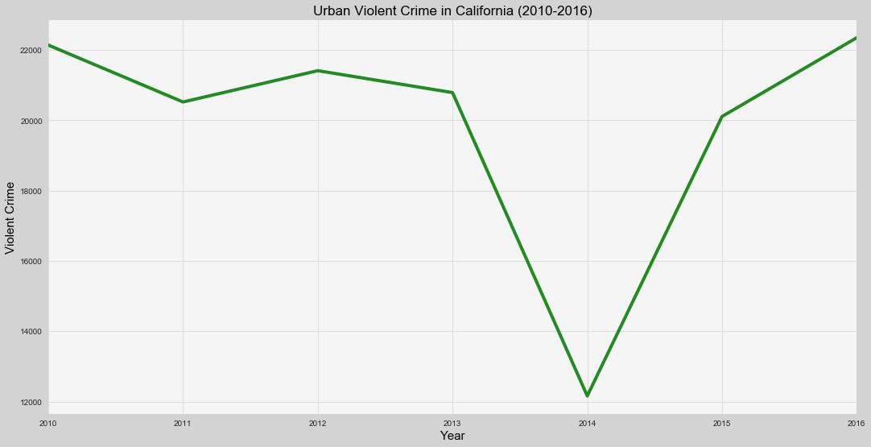
URBAN CRIME OVER 2010-2016
Recreational
Retail
COLORADO
WASHINGTON
OREGON
CALIFORNIA

Slide 22
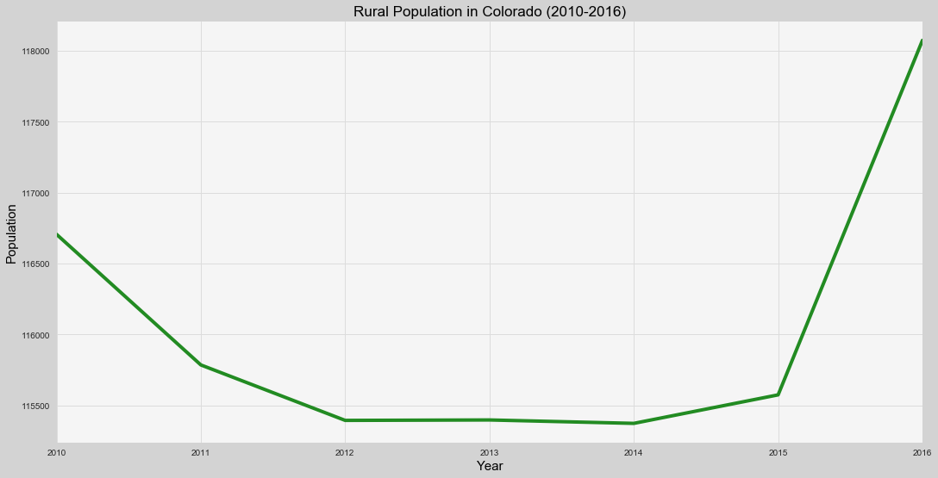
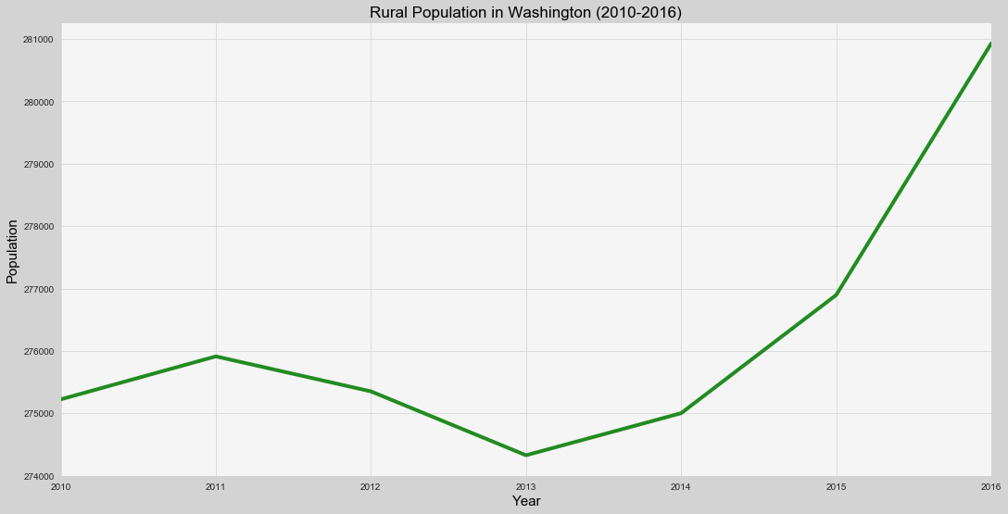
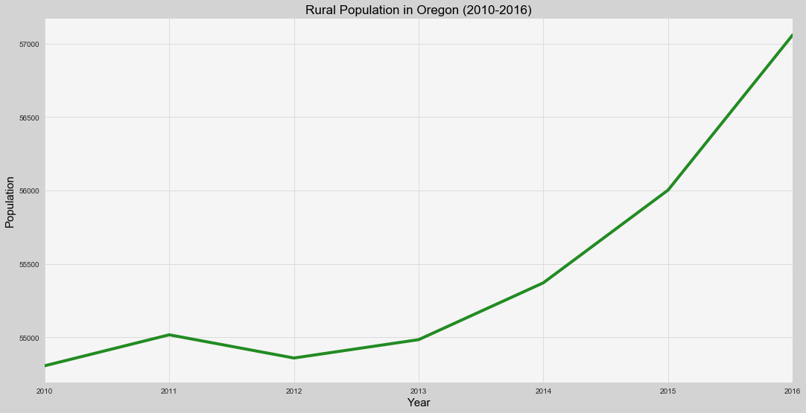
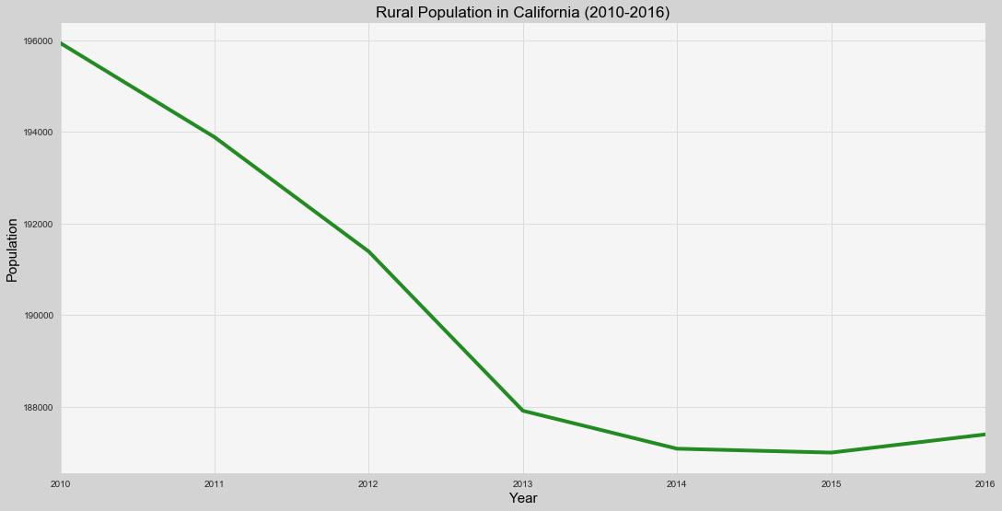
RURAL POPULATION OVER 2010-2016
Recreational
Retail
COLORADO
WASHINGTON
OREGON
CALIFORNIA

Slide 23
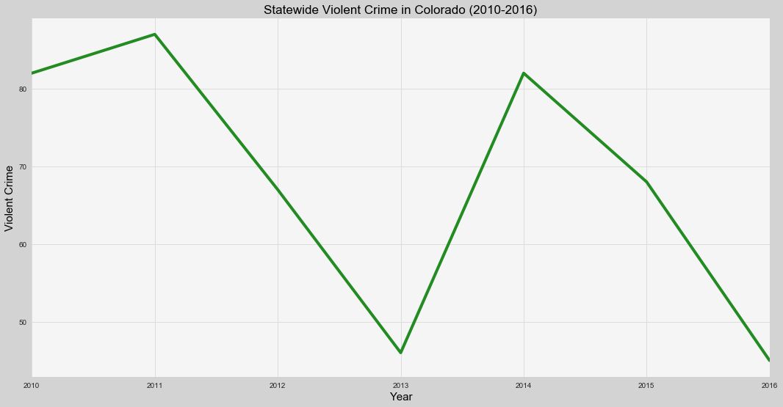
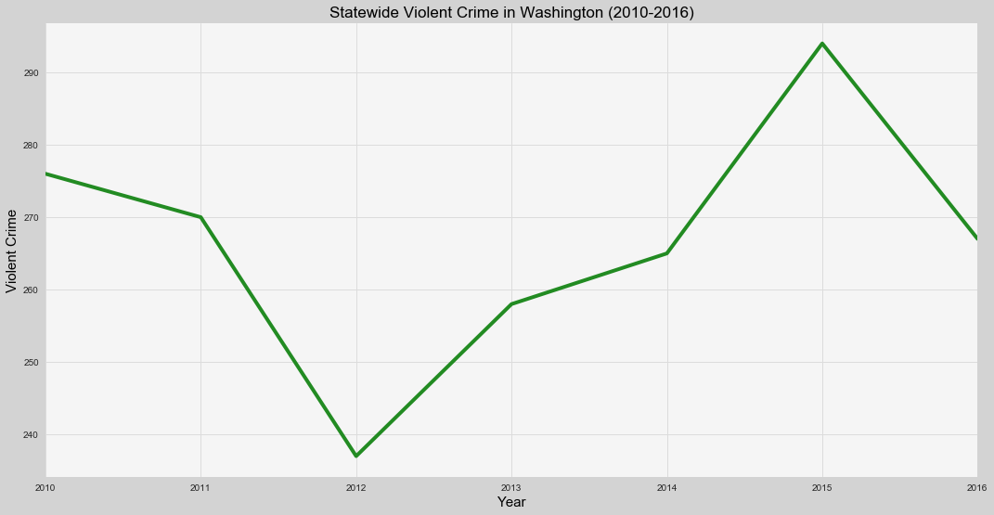
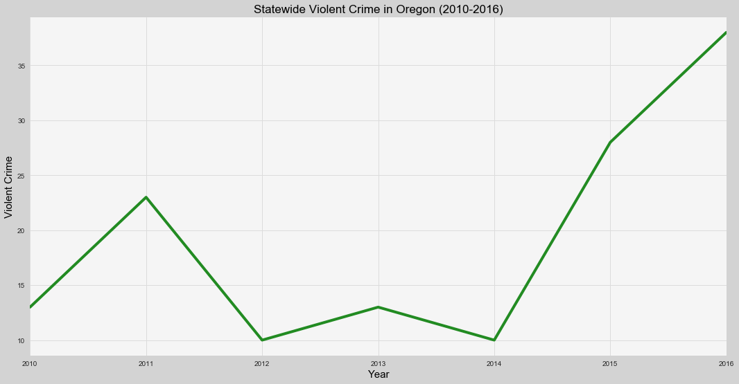
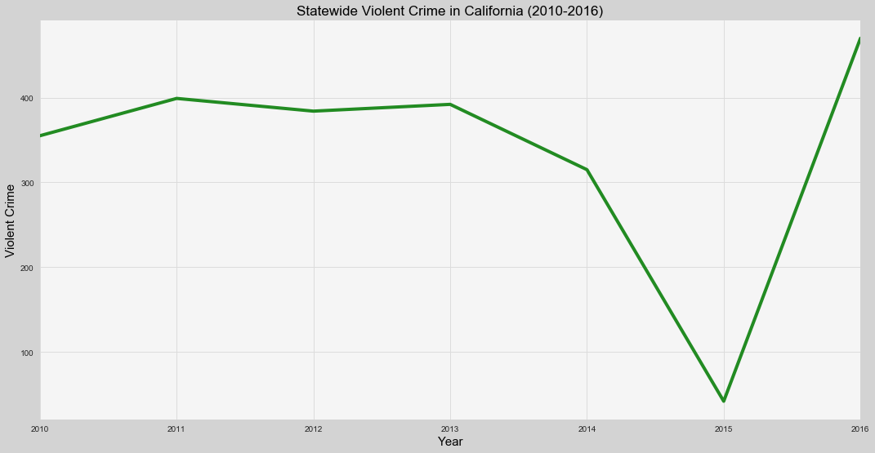
STATE-WIDE VIOLENT CRIME OVER 2010-2016
Recreational
Retail
COLORADO
WASHINGTON
OREGON
CALIFORNIA
Notes:
Rename slide!!!

Slide 24
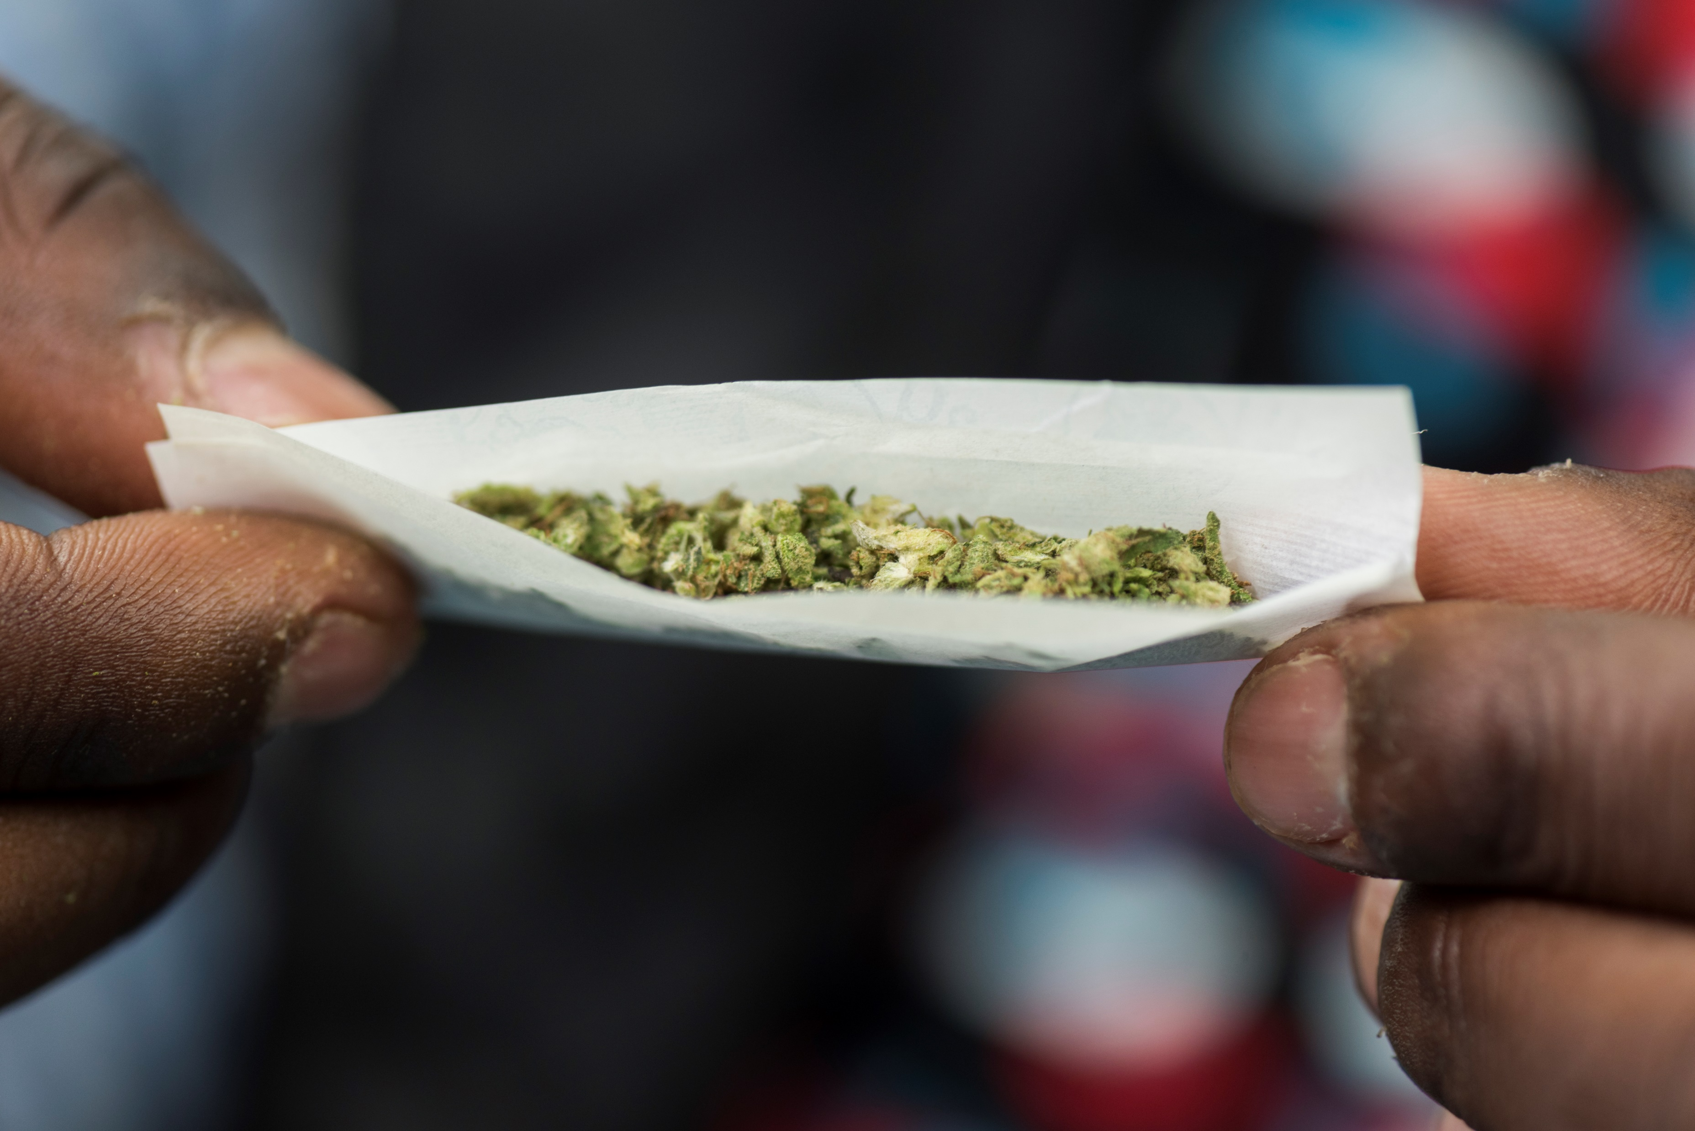
DISCUSS & CONCLUDE
PART 4

Slide 25
OUR FINDINGS
DID WE FIND WHAT WE EXPECTED TO FIND?
IF NOT, WHY/HOW
DISCUSS & CONCLUDE
25
Notes:
Was our hypothesis correct?
If not what were the relationships we saw?
If so, yay

Slide 26
THE CONCLUSION… FOR NOW
WHAT INFERENCES OR GENERAL CONCLUSIONS CAN YOU DRAW FROM YOUR ANALYSIS
DISCUSS & CONCLUDE
26
Notes:
No correlation on statewide or urban scale, but there is a correlation on a rural scale.
Not enough data…

Slide 27

LESSONS LEARNED
PART 5

Slide 28
DATA SNAFFUS
CHALLENGES FACED
Inconsistencies in raw data across like categories or datasets
Lack of available data after 2016
LESSONS LEARNED
28
Notes:
These are the difficulties that arose and how we dealt with them…

Slide 29
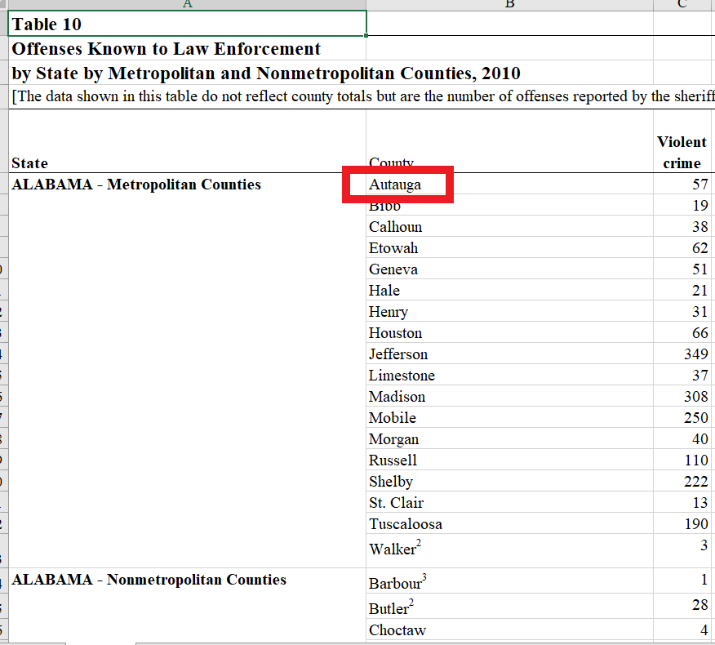
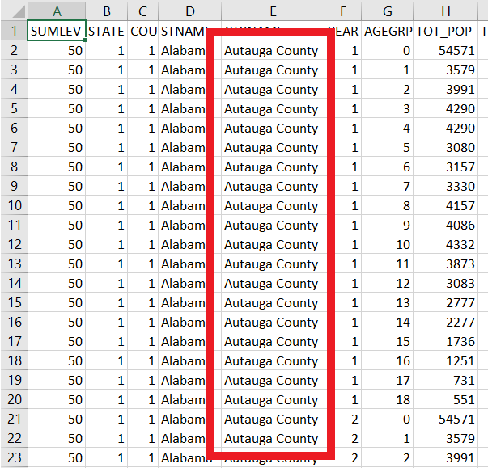
EXAMPLE:

Slide 30
IF WE HAD 2 MORE WEEKS…
INCLUDE MEDICAL MARIJUANA
SEPARATE OUT DIFFERENT CATEGORIES OF CRIME
RESEARCH IMPACT OF OTHER DRUGS
EXPAND SCOPE OF STATES /
LOOK AT US TOTALS & AVERAGES
LESSONS LEARNED
30
Notes:
Separating crime into individual categories.
Introducing other drugs

Slide 31
SPECIAL THANKS
Our Instructor and TAs:
REED
&
JORDAN
aka “Justin”
&
TRAVIS
aka “Jordan”
LESSONS LEARNED
31

Slide 32
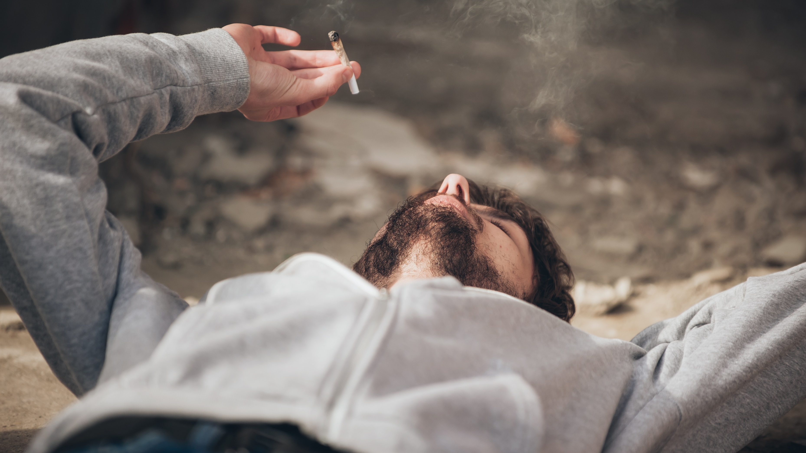
Q&A
FIN

